Slide 1

Commercial Management of
Mid & Back Office Services:
        Enron’s transactions with others
        External clients with specific service requirements
April 2001

Slide 2

Key Meeting Take-aways
We will now price operationally intensive deals
We are planning to intensify efforts to sell operational services to external parties
We will be asking for your help as we define the right way to sell, define, price and offer deals with operational components

Slide 3
Internal Structure – What has Changed?
Process
Pros
Cons
Before
Deals done without pricing from operations desk
Services offered without energy operation’s knowledge
Hidden costs may overwhelm profitability
Inconsistent service levels
Deal components not quantified
Now
Deals requiring pricing and signed DASH from operations desk:
  Asset Management transactions
  Acquisitions
  Any deal with a service component (regardless of the underlying commodity commitment)
  Any commodity deal with non-standard delivery mechanisms
Measures true profitability
Increased level of service
Coordinated approach to the marketplace
Consistent pricing methodology
Notes:
Originators will market the services to customers.
Originators will get pricing from a desk before serving prices to a customer.
ENE systems support personnel will continue to support the back office systems.
EnronOnline help desk will provide support for customers.

Slide 4
Overview of the Operations Desk
Created during Fall ’98 to manage efficient growth
  Model originated by Andersen
  Developed to identify opportunities for automation
  Established to price operationally intensive transactions
Refined during ’99 and ’00
  Tailored to the changing businesses
  Staffed with operations and pricing experts
  Modeling increased from quarterly to monthly
Positioned to enable commercialization efforts
  Cost variability with scalability of business
  Individual cost drivers for each process
  Example work:
    Bridgeline
    HPL
    Victoria Gas
Midwest LLC
Apache
Commodity Logic

Slide 5
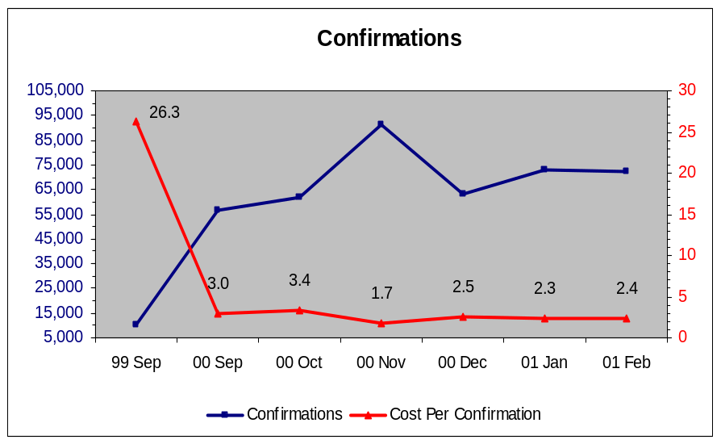
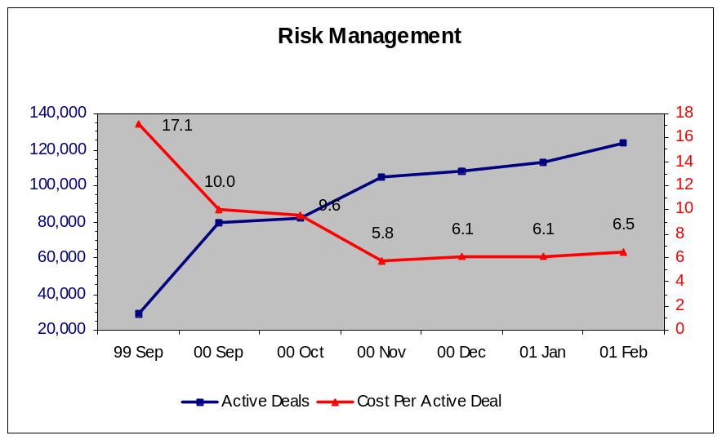
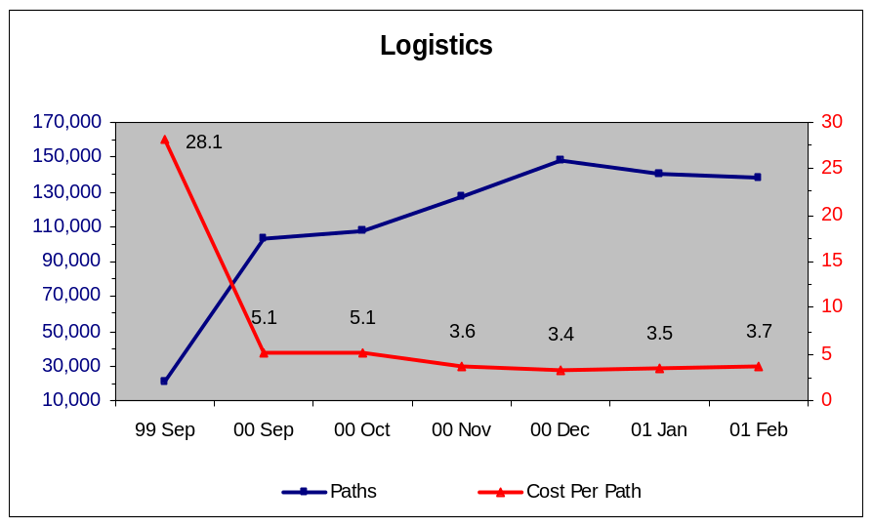
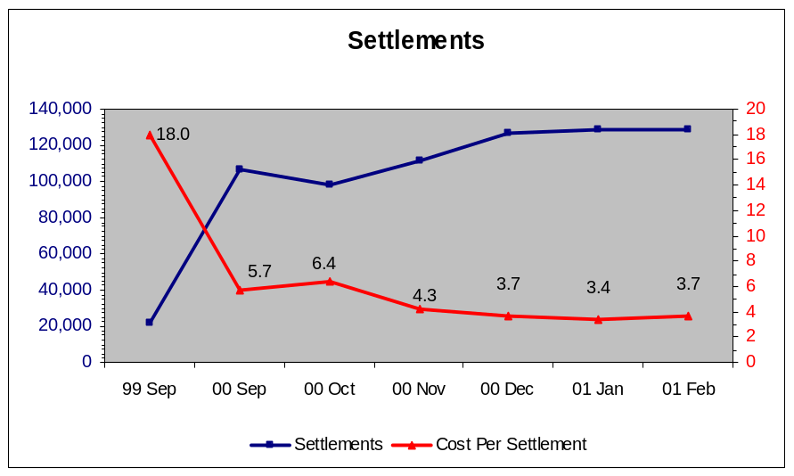
Operations Desk Pricing Example :

Slide 6
How will the Operations Desk Work?
Deal Data
Customer
Back Office
Services
Operations
Desk
Requirements
Price + margin
Deals
Originator
Price
Back Office Desk controls pricing levels
Originators receive a transaction price
Keep excess over prices quoted
Charged back for selling under price quoted

Slide 7
External Market: How will Origination Work?
Originators
(ENA & ENW)
Back Office = Commercial
  Pricing comes from a desk
Multiple distribution channels:
  ENA Originators : existing relationships
  ENW Originators : New / Direct relationships and business development
Distribution channels will work with domain experts toward closing the deal
BO
Desk
Notes:
Originators will market the services to customers.
Originators will get pricing from a desk before serving prices to a customer.
ENE systems support personnel will continue to support the back office systems.
EnronOnline help desk will provide support for customers.

Slide 8
What Commodity Types are Supported?
Initial mid and back-office services for third party customers will support:
  Physical gas
  Financial gas
  Physical Power
  Financial power
More product-types will be supported in the future

Slide 9

Why this Service and Why Now?
Addressable North American Market is
$419,000,000
Monetization opportunity brought about by our systems which allow:
  Scalability
  Best-in-class performance
  Efficiencies across the board
Marginal
Cost Per Transaction
(Indexed)
100
25
1999
2000

Slide 10
Approach to Market
Segment:
The market is segmented by transaction volumes
Target:
The target market is the middle and lower tier of the market
Positioning:
Best-in-class systems
Allows firms to concentrate on their core operation
No maintenance or infrastructure expenses
Reduce development risk
Keep up with changing technology - upgrade with Enron
Grow as your needs grow
Notes:
Approach to market
Pitch
Service Level Agreements
Pricing Methodology

Slide 11
What are the Services?
Initially, services offered will include:
  Deal capture and confirmation services
  Reporting
  Logistics and scheduling services
  Volume management (Actualization)
  Settlements (cash collection / payment and reconciliation)
  AR/AP accounting entries
Future offerings will include other bundled services, e.g. risk reporting, etc.

Slide 12
What is the Process?
A New Deal
Each new transaction goes through this process
  This includes EOL and non EOL deals
    This applies to all physical commodities, Physical Gas, Physical Power, etc . .
        Financial Transactions skip
        Logistics & VM
Trade Capture
Deal Compliance
Risk Mgmt
Logistics
Volume Mgmt
Term Deals repeat the process
Each active deal repeats this process (excluding trade capture)
  An average Physical Gas term deal is active about 9 months
    An average Financial Gas term deal is active about 2 months
      An average Physical Power deal is active about 4 months
Cash Mgmt

Slide 13
Next Steps
Identify customer needs
Receive marketing assistance from operations experts if deal meets requirements
Determine deal terms and specifications and draft a pricing sheet
Receive offers from desk
Follow deal procedures
  Management approval
  Pricing sheet
  DASH
Contract signed

Slide 14
Support and Contacts
Originator
Originator
Originator
Originator
Originator
Structuring /
Pricing:
Beth Apollo (3-5014) until June 1
Todd Busby (3-6880) thereafter
Operations
Pricing Model:
James
Scribner
Physical Gas
Experts:
Bob Hall
Bob Superty
Power
Experts:
Leslie Reeves
Thresa Allen
Financial Deal
Experts:
Leslie Reeves
Kim Therio
Technology:
Beth Perlman

